Slide 1

Polynomial Protocol
One stop DeFi options protocol

Slide 2

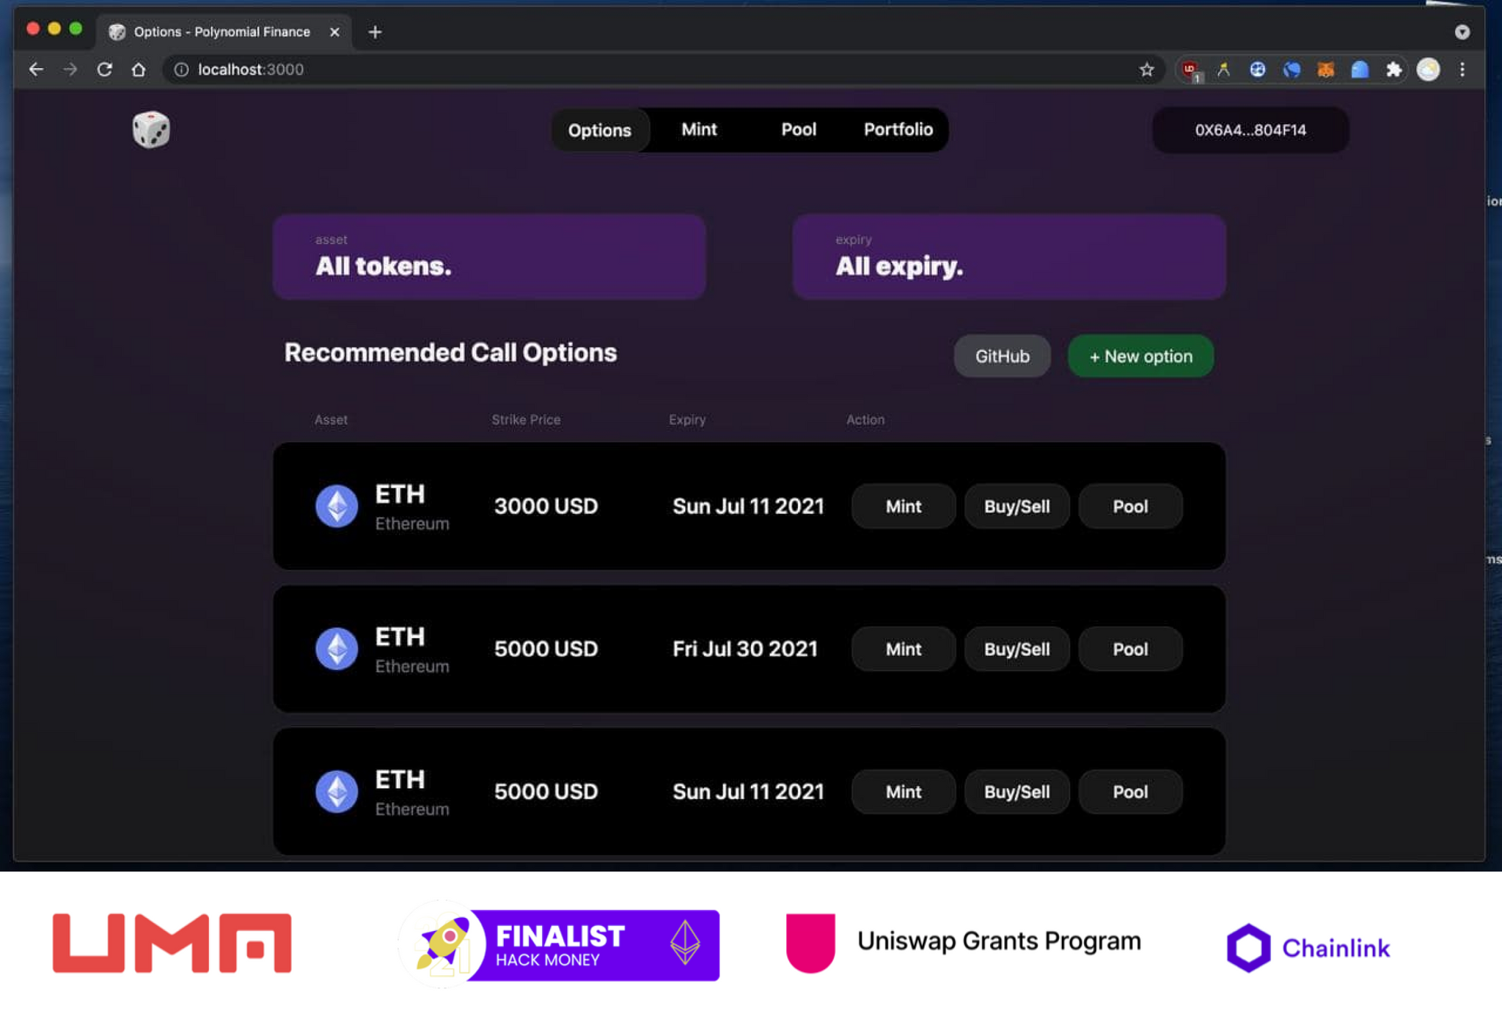
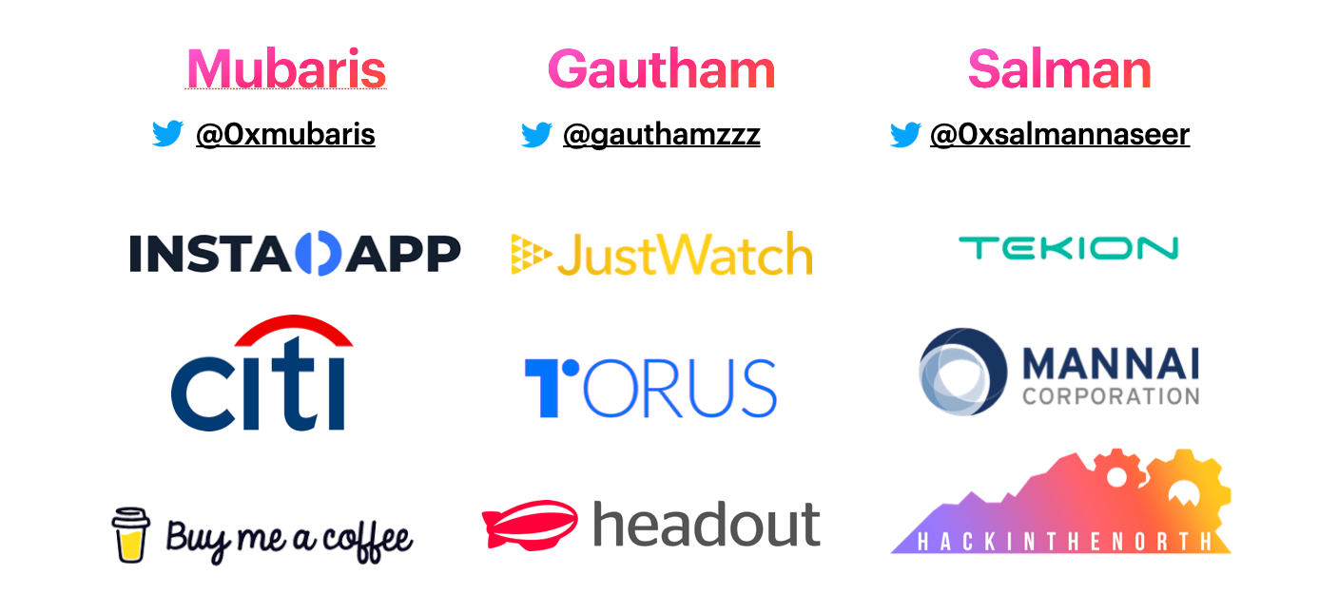
🤝 Team
😇 Started from Hackmoney 2021

Slide 3
😱 Options are a $300 trillion market
Derivatives in DeFi are just getting started. Often estimated at over $1 quadrillion on the high end

Slide 4
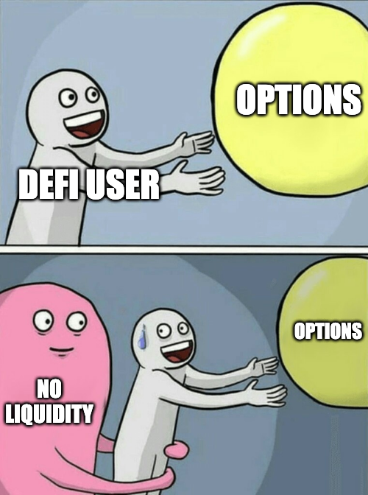
🤔 why?
On-chain options are expensive

Slide 5
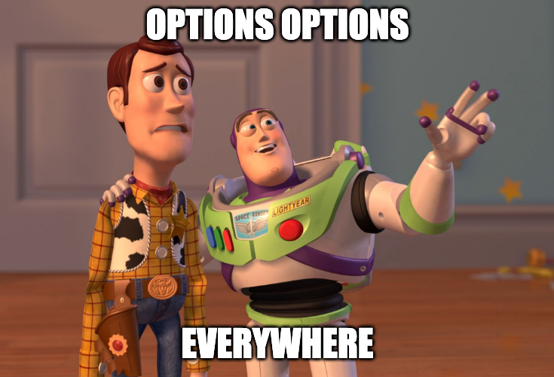
So many options protocols!
There are a lot of option protocols, but the liquidity is fragmented.
This results in a steep option premium.

Slide 6
Solution
🔥 Option Aggregation
🦄 Option Liquidity Protocol
🚀 Structured Products

Slide 7
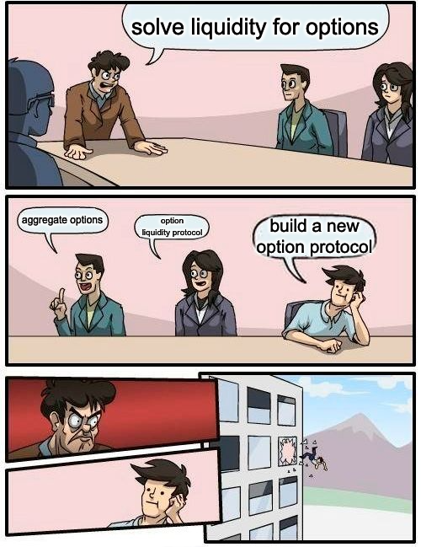

Slide 8
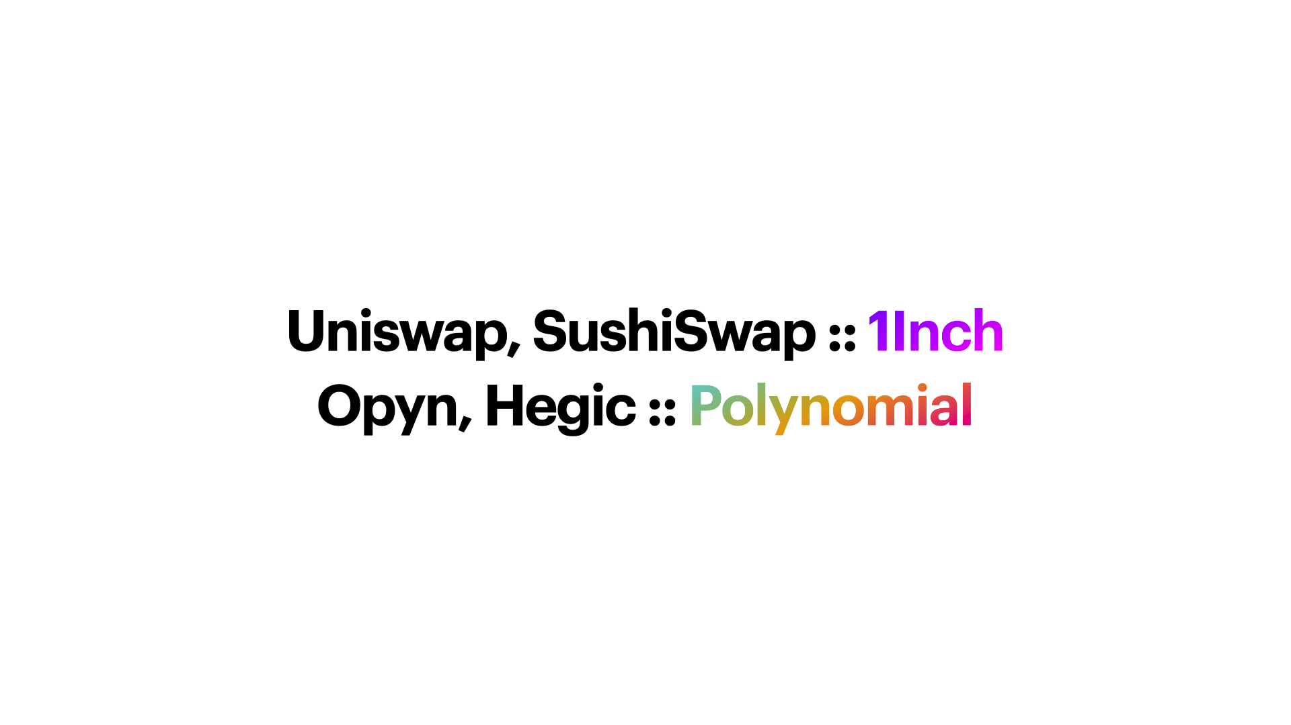

Slide 9
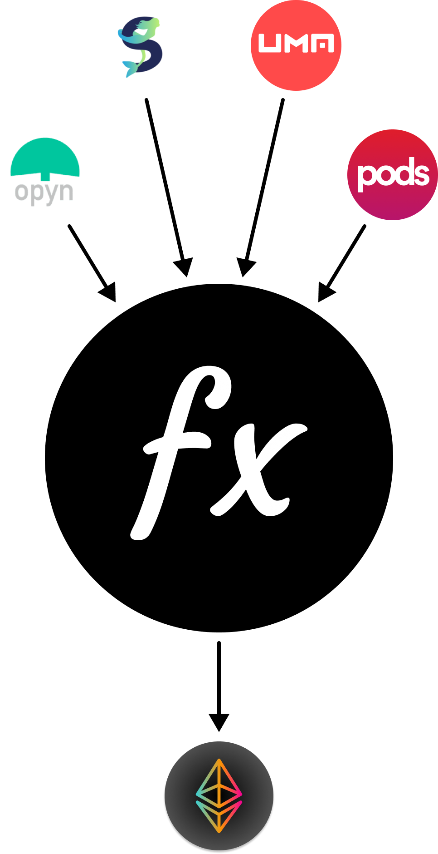
🔥 Option Aggregation
Polynomial brings multiple on-chain option protocols in a single venue, encouraging arbitrage and competitive pricing.

Slide 10
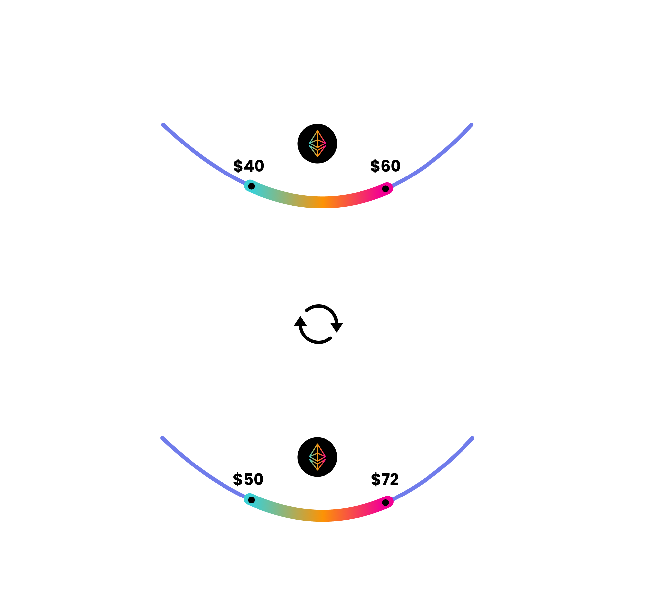
🦄 Option Liquidity Protocol
Polynomial offers optimized liquidity for options through Protocol Controlled Liquidity (PCL).
Lower option premiums, higher upside.
Uniswap v3 under the hood with Black-Scholes for rebalancing

Slide 11
🚀 Structured products
Income based strategies: Put selling, Call selling, etc...
Volatility based strategies: Long vol, Short vol, etc..

Slide 12
Targeted Networks
💪 Ethereum
🌍 Arbitrum
⭕️ Optimism

Slide 13
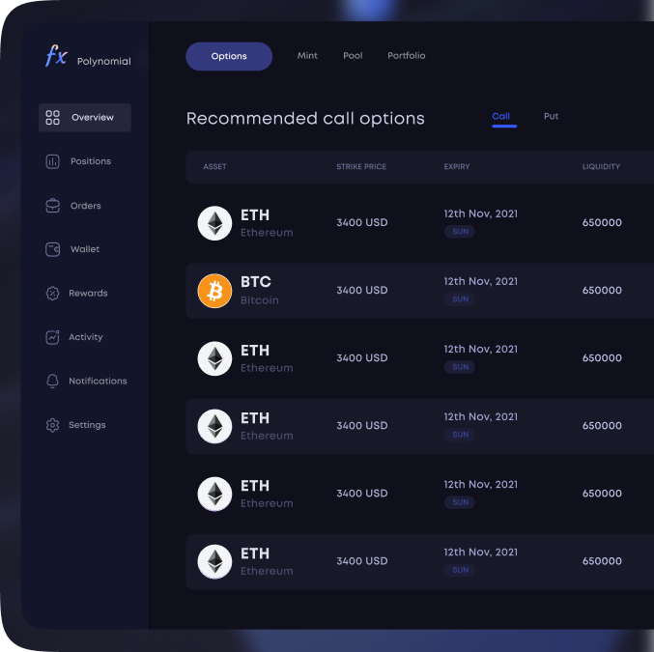
⚙️ Testnet soon™️

Slide 14

Thank you

